Slide 1
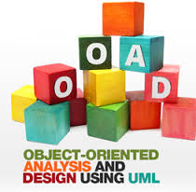

Course Name object oriented analysis and design
CSC 2210
(Undergraduate)
Software engineering (Undergraduate)
Chapter 1 why do we model things?
MOHAIMEN-BIN-NOOR
Assistant Professor, CS
mohaimen.niloy@aiub.edu

Slide 2
What is a System?
Chapter 1: Why do we Model things
MOHAIMEN-BIN-NOOR
S.2
MM
A system has a specific set of objectives.
Components of a system are given a specific set of tasks/ responsibilities.
Components of a system work together to achieve those objectives within a limited boundary.
Components are related with each other and communicate with each other based on the type of the relationships.

Slide 3
Quality of a System
Chapter 1: Why do we Model things
MOHAIMEN-BIN-NOOR
S.3
MM
Objectives must be well defined and specific
Components must have well defined and specific responsibilities that they can perform independently.
Communication among components should be as minimum as possible; only on need basis to transfer the output of one component to another component.

Slide 4
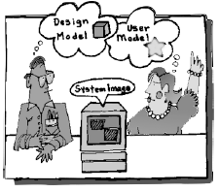
Why we model?
Chapter 1: Why do we Model things
MOHAIMEN-BIN-NOOR
S.4
MM
A model is a simplification of reality
A model provides the blueprints of a system.

Slide 5
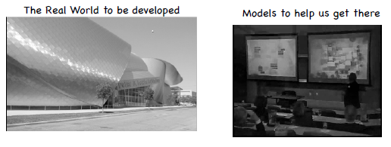
Why we model?
Chapter 1: Why do we Model things
MOHAIMEN-BIN-NOOR
S.5
MM
The larger and more complex the system, the more important modelling becomes, for one very simple reason: We build models of complex systems because we cannot fully mean of such a system in its entirety.
There are limits to the human ability to understand complexity. Through modelling we narrow the problem we are studying by focusing on only one aspect at a time.

Slide 6
Why we model?
Chapter 1: Why do we Model things
MOHAIMEN-BIN-NOOR
S.6
MM
Modeling is the designing of software applications before coding.
Modeling is an Essential Part of large software projects, and helpful to medium and even small projects as well.
Modelling is a proven and well-accepted engineering technique.
Unsuccessful software projects fail in their own unique ways, but all successful projects are alike in many ways.
There are many elements that contribute to a successful software organization; one common thread is the use of modelling.
We do model so that we can better understand the system we are developing.

Slide 7
Benefits of model
Chapter 1: Why do we Model things
MOHAIMEN-BIN-NOOR
S.7
MM
Through modelling we achieve four aims:
Models help us to visualize a system as it is or as we want it to be
Models permit us to specify the structure or behaviour of a system
Models give us a template that guides us in constructing a system
Models document the decisions we have made

Slide 8
Principles of Modelling
Chapter 1: Why do we Model things
MOHAIMEN-BIN-NOOR
S.8
MM
1. The choice of what models to create has a profound influence on how a problem is attacked and how a solution is shaped.
In other words, choose models intelligently. The right models will illuminate the wicked development problems.
2. Every model may be expressed at different levels of precision.
Sometimes a quick and simple executable model of the user interface is exactly what you need; at other times, one has to get down and dirty with the bits. The best kinds of models are those that let you choose your degree of detail, depending on who is viewing and why.

Slide 9
Principles of Modelling
Chapter 1: Why do we Model things
MOHAIMEN-BIN-NOOR
S.9
MM
3. The best models are connected to reality.
A Model connected to reality makes it more understandable and presentable. The more abstract a model is the more it needs to be closer to reality.
4. No single model is sufficient.
Every nontrivial system is best approached through a small set of nearly independent models

